Slide 2
Spotify Recommender Engine
Team 4 – Assignment 1.4
Leo Li, Cilai Jin, Abhiraj Chaudhary, Abigail Watts

Slide 3
Model Overview
Importing data
Data exploration: finding correlations
Removing outliers
Grouping clusters
Clustering algorithms
User interaction
User feedback
Future enhancements
Innovation

Slide 4

Enhancements Made

Slide 5
Removing outliers
# Identify outliers
Reduce the noise
Help the model focus on main correlations
IQR over z-score
Merging both methods
Identifies data
Multiplier of 1.5

Slide 6
Normality test

Slide 7
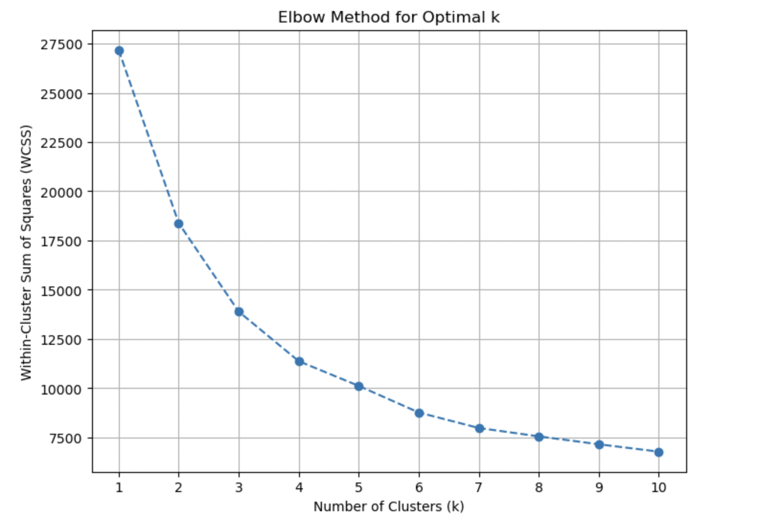
Determining cluster number for Kmeans model: Elbow Method
determine optimal number of clusters
plotting WCSS
Identifies "elbow" point
k = 3

Slide 8
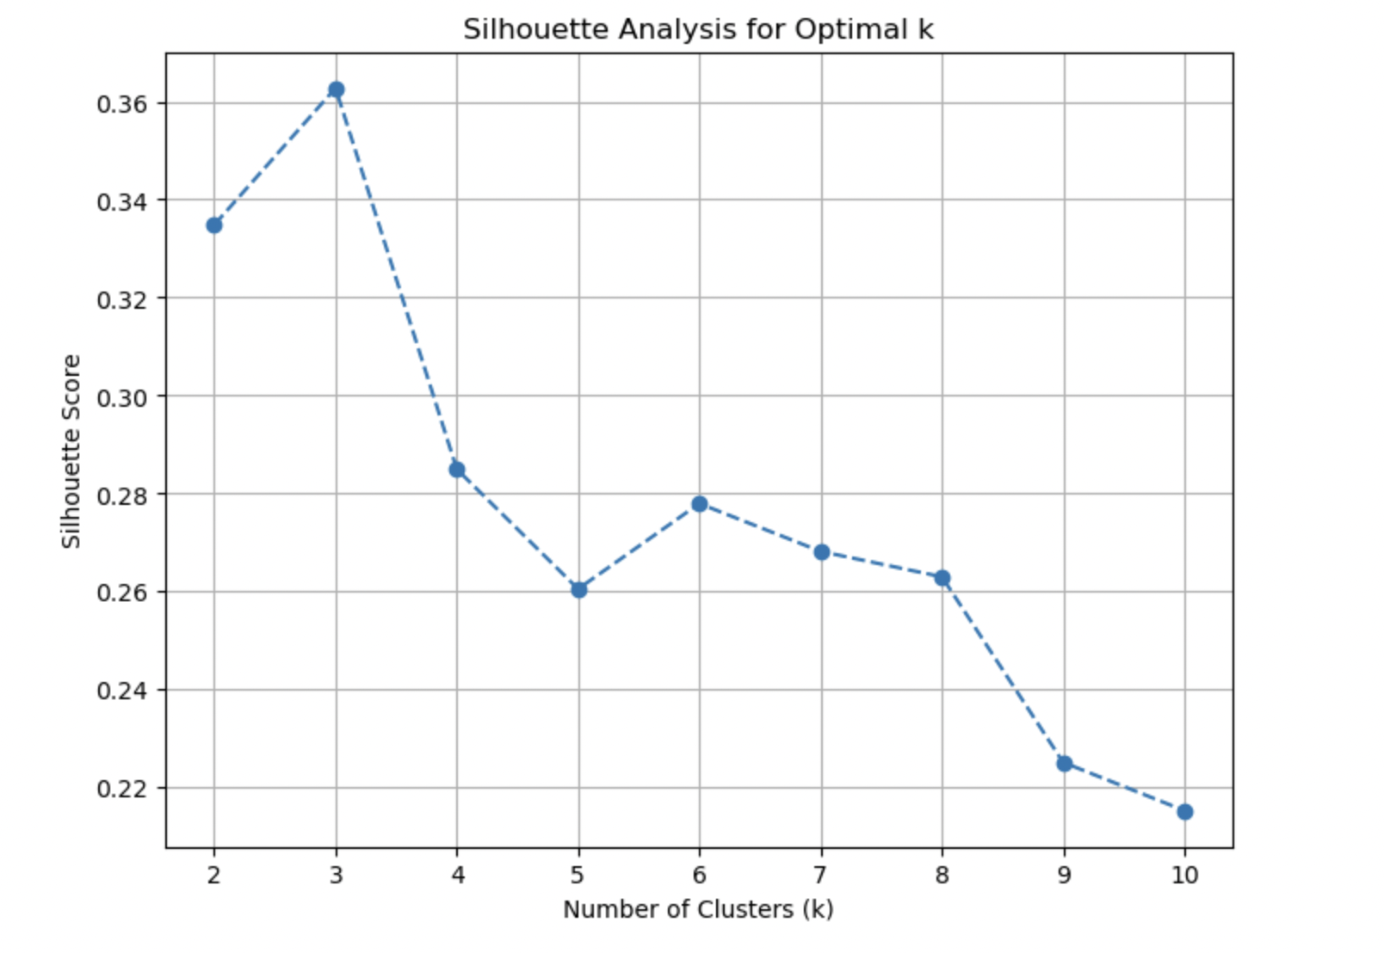
Determining cluster number for Kmeans model: Silhouette method

Slide 9
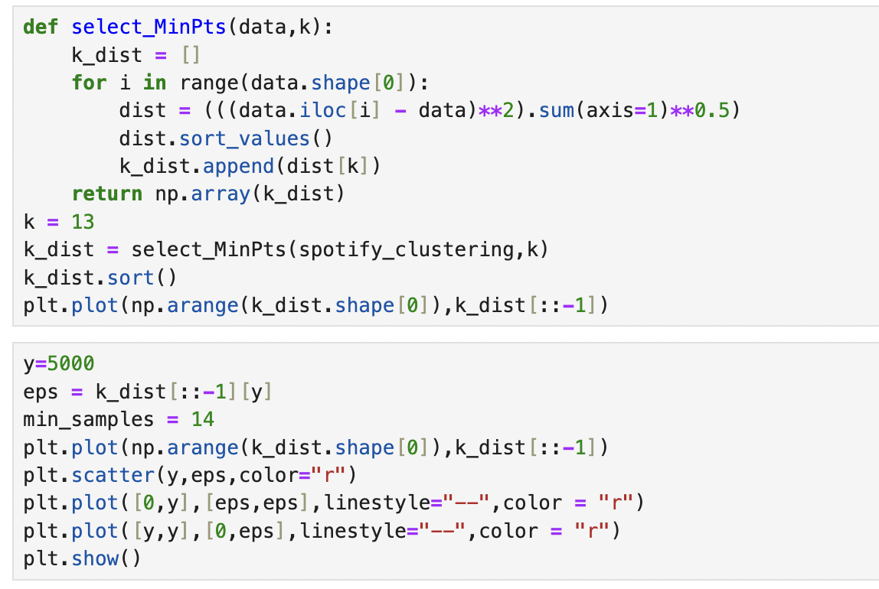
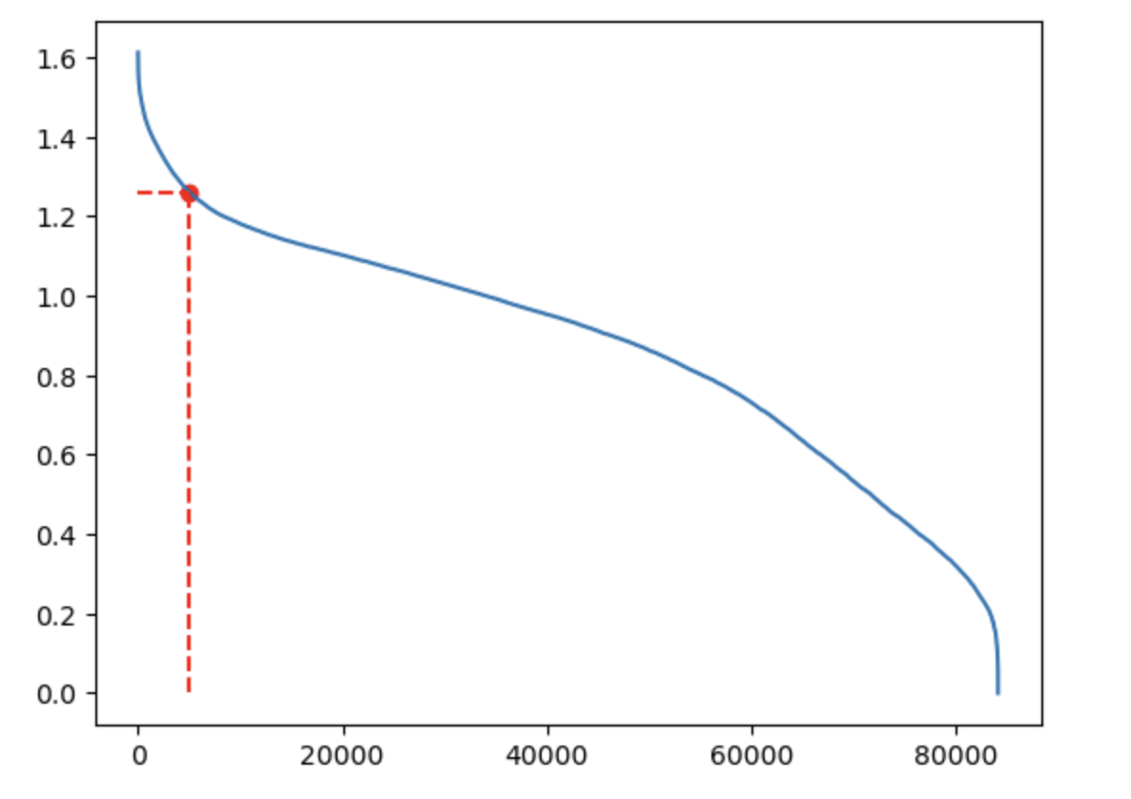
DETERMINING eps and min FOR DBSCAN MODEL: k-distance curve

Slide 10
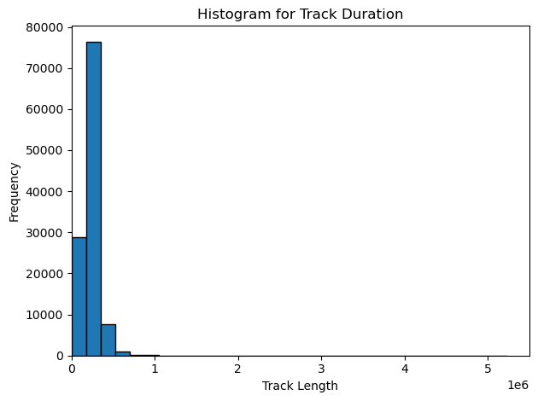
Findings from Data
Track duration have a big range, but follows a normal distribution to an extent

Slide 11
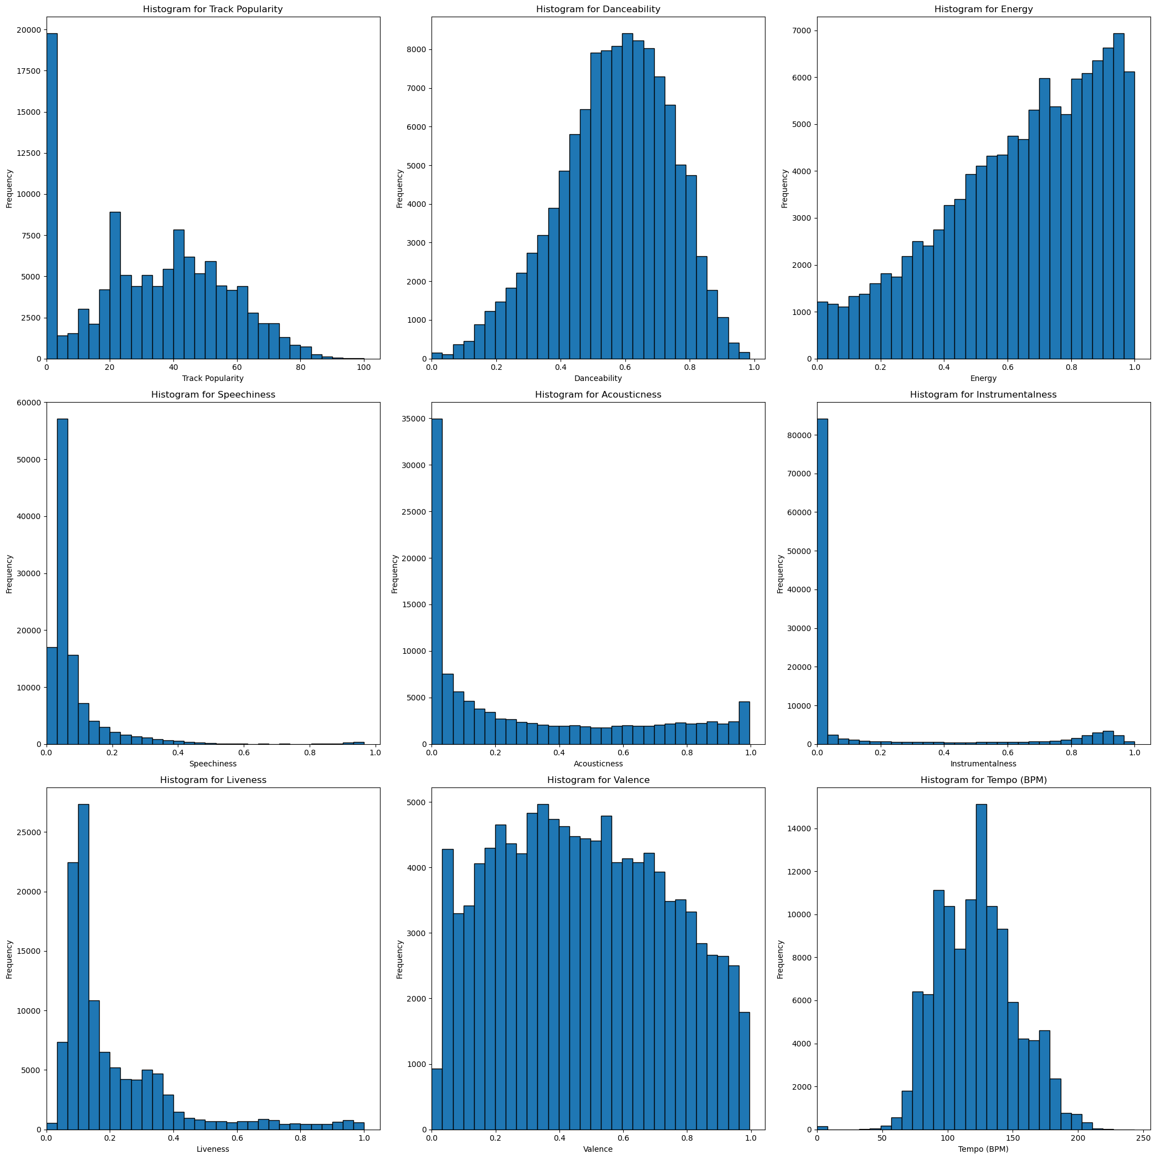
Findings from Data
Properties are mostly distributed in a clear pattern

Slide 13
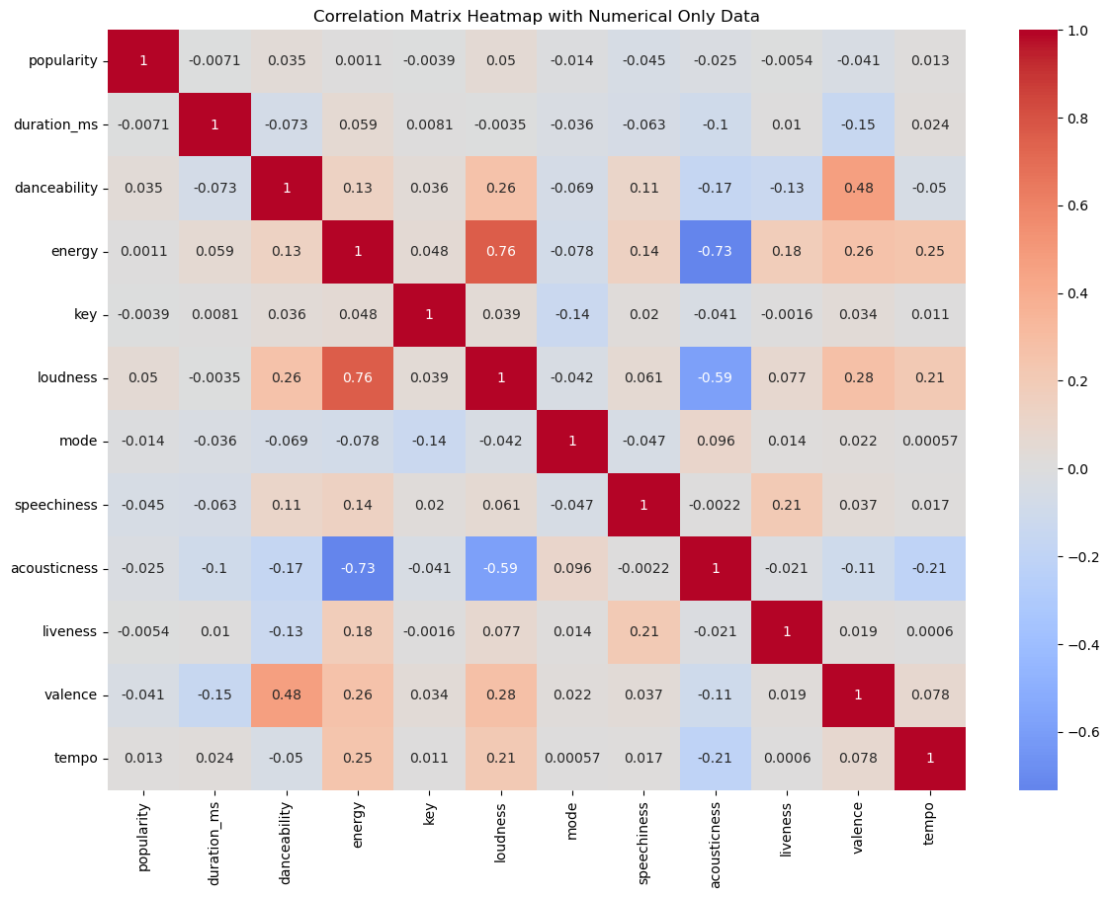
Findings from Data: Histogram
Not a lot of correlation with music properties with popularity
Correlation only between properties
Loudness and Energy
Acousticness and Energy

Slide 14
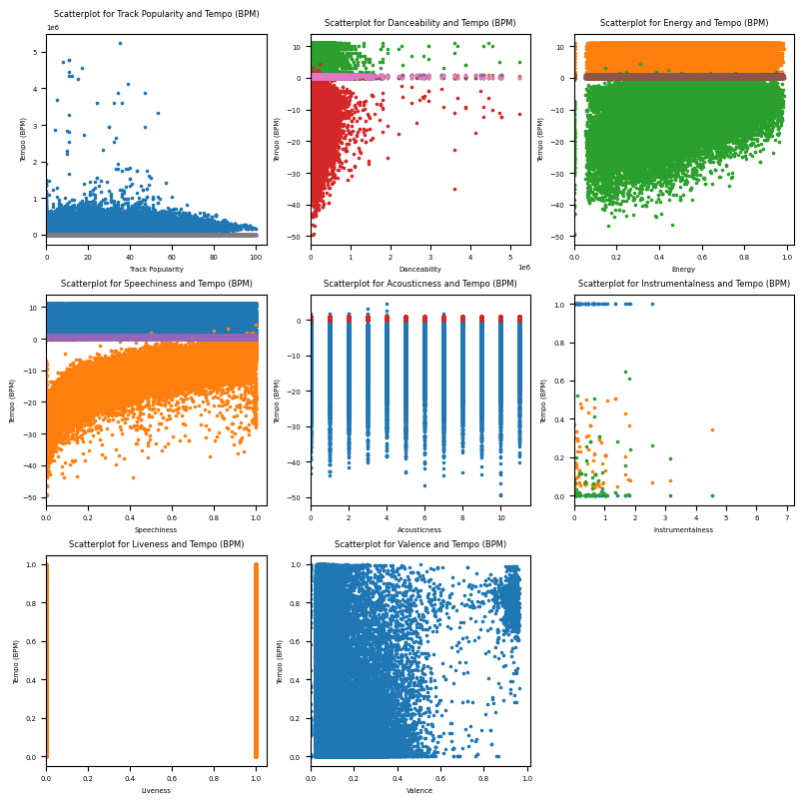
FINDINGS FROM DATA: Scatterplot

Slide 15
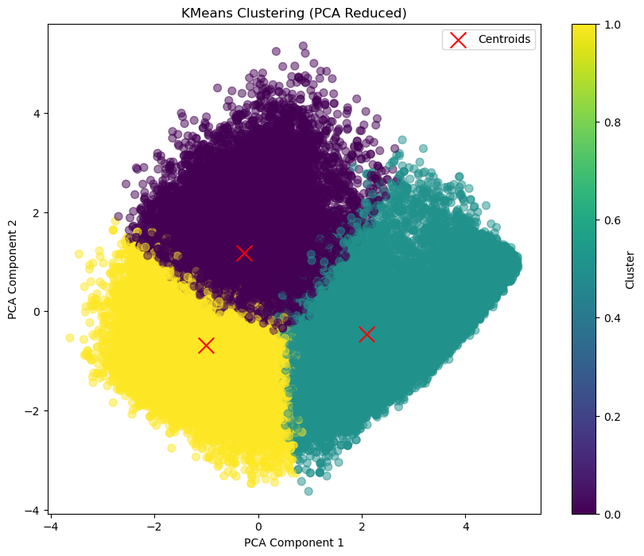
Different Clustering Algorithms
K Means Model
Performance:
K Means model is extremely efficient and effective at handling large datasets and is the least computationally expensive as it can produce results in a matter of seconds.
Plot:
K means shows each data point that is assigned to a cluster, a centroid that shows the mean position of all the points in the cluster. In this case, there are 3 clusters with some overlaps meaning they may not be exactly distinct from each other, and the data points are fairly spread out meaning higher variance among clusters.
Cons:
Not resistant to outliers and requires the exact number of clusters.
Pros:
Computationally efficient, straightforward, scalable, and easy to interpret.

Slide 16
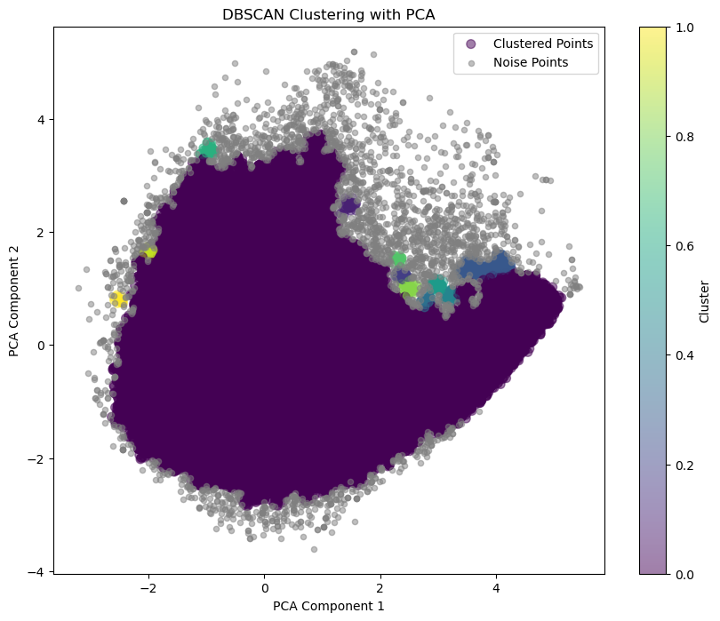
Different Clustering Algorithms
DBSCAN
Performance:
DBSCAN: Is fairly good at handling large datasets but requires a longer time than K Means.
Plot:
DBSCAN represents clusters by depending on the regions of density of data points. In this case, cluster 0 is the most predominant cluster there is.
Cons:
DBSCAN: Extremely sensitive towards parameter specifications and can affect accuracy in determining clusters.
Pros:
DBSCAN: Resistant towards outliers, noise does not heavily impact clusters, and can handle varieties of clusters.

Slide 17
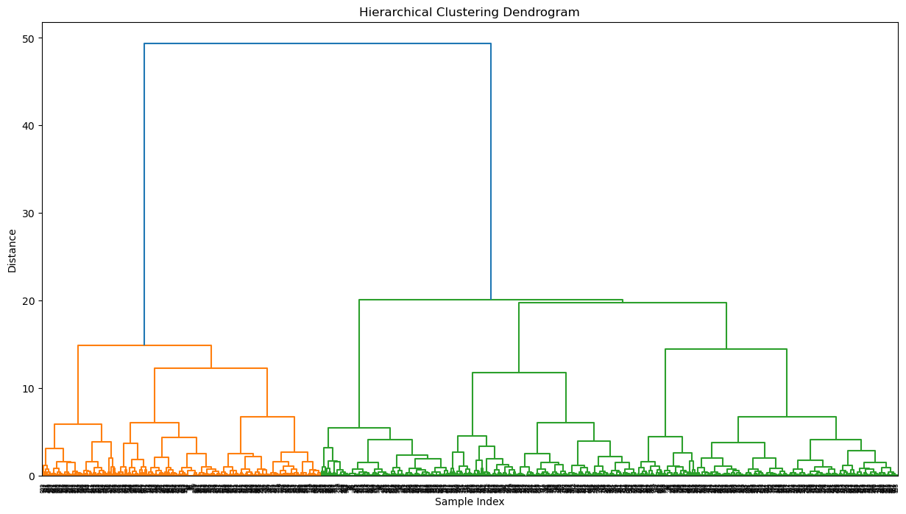
Different Clustering Algorithms
Agglomerative Clustering
Performance:
The most computationally expensive method of handling large datasets and can easily cause memory overflows if the system is not equipped for handling it. This is due to having to calculate every pairwise distance between each datapoint and its polynomial growth.
Plot:
Agglomerative clustering is a hierarchical clustering algorithm where each datapoint starts with an individual cluster but will eventually merge together depending on the similarity of each data point creating a hierarchy of clusters. Therefore, it can be expressed as a Dendrogram.
Cons:
Agglomerative: Computationally expensive and cannot handle large dataset as it can cause memory overflows
Pros:
Agglomerative: Does not require exact number of clusters, and can reveal insights by its hierarchical structure

Slide 18
User interaction - Recommendation

Slide 19
User Feedback Incorporation
User feedback like star ratings or ratings on a scale of 1-5 can be incorporated which can help the model recommend songs similar to those kind of songs that two users have rated closely.
A sort of time series analysis can help the recommender engine perform better as it can recommend songs similar to those which a user has a history of listening to for long periods of times.

Slide 20
Future Enhancements Possible
Use of generative AI to increase personalization, add a human-like touch, and make the experience more user interactive.
Implementing a continuous learn system where the recommendation engine updates a system generated playlist based on what all the user listened to a little time back and what they may listen to in the distant future.
⁠⁠Making Context-aware recommendations like making a recommendation based on what the time of the day is, what’s their location, what’s the weather like, what they just did (Activity), etc. Doing this would help make the process much more personalized.
Recommending some new songs to the user to allow them to explore more types of songs which they may or may not like. Their liking of the new song can be inferred by if they listened to the whole song or not, when they skipped it, how much did they forward, did they add the song to any of their own playlists, etc.

Slide 21
Extra – Innovation
Tracks with popularity greater than 90

Slide 22
Extra – Innovation
Creating a list with tracks that is popular and not included in the existing playlist of the user
Play list generated randomly, with at least 20 tracks with a popularity above 80, at least 10 above 85, and at least 5 above 90.

Slide 23
Thank You for Listening

